Slide 1
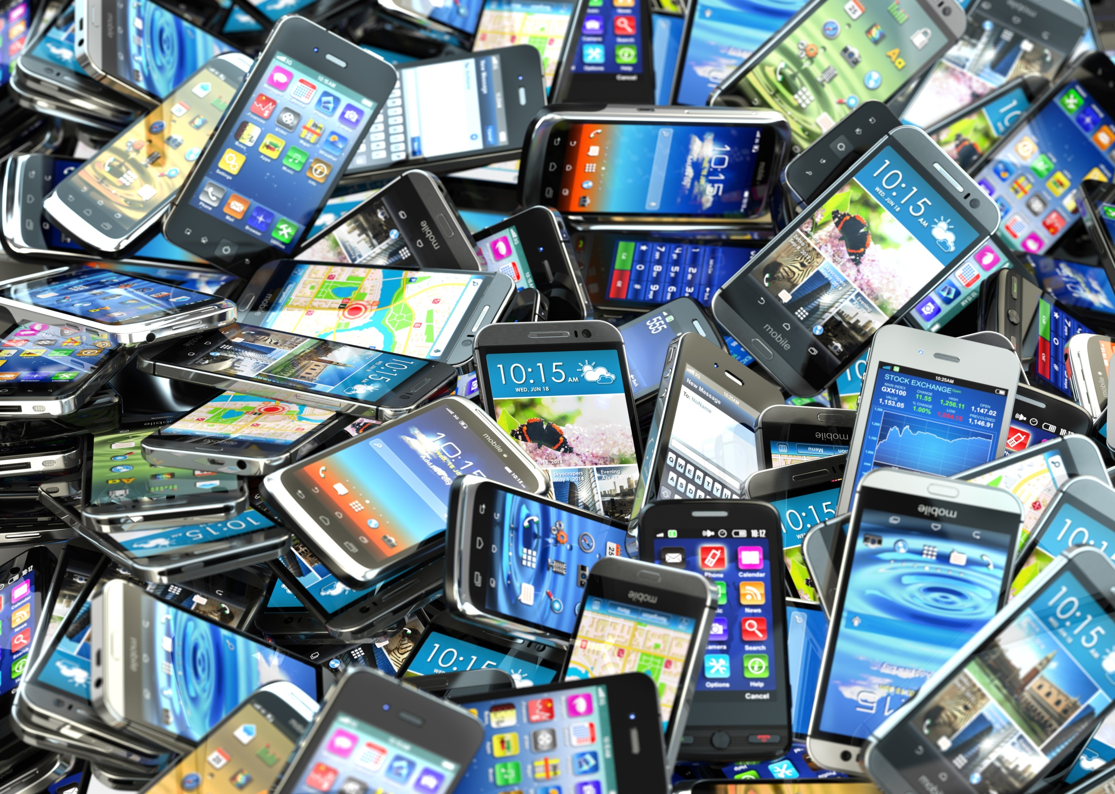

Wireless Fundamentals Jeopardy
October 14, 2019 | v. 1.0

Slide 2
Wireless Funpardy
Final Funpardy
Evolution of Wireless Technology | Generations | Network | Internet of Things (IoT) | IoT Connected Community | Wireless Fun Facts
$200
$200
$200
$200
$200
$200
$400
$400
$400
$400
$400
$400
$600
$600
$600
$600
$600
$600
$800
$800
$800
$800
$800
$800
$1000
$1000
$1000
$1000
$1000
$1000

Slide 3

Evolution of Wireless Technology
$200
Clue:
The decade Cool Ranch Doritos, the Rubik’s Cube, and the first commercial wireless network was built.

Slide 4
Evolution of Wireless Technology
$200
Answer:
What is the 80’s?

Slide 5
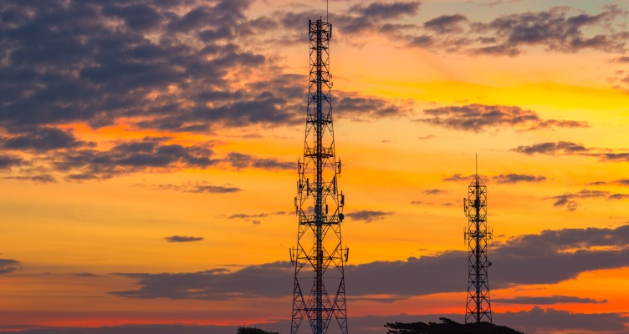
Evolution of Wireless Technology
$400
Clue:
The year the first cellular service launched.

Slide 6
Evolution of Wireless Technology
$400
Answer:
What is 1983?

Slide 7

Evolution of Wireless Technology $600
Clue:
The highly anticipated next generation of wireless.

Slide 8
Evolution of Wireless Technology $600
Answer:
What is 5G?

Slide 9
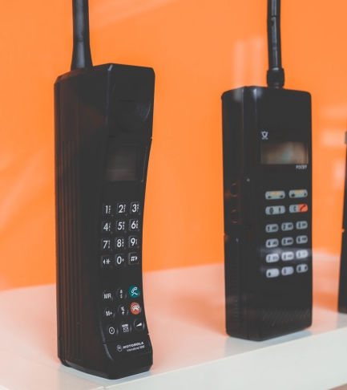
Evolution of Wireless Technology $800
Clue:
The Zach Morris 1G bag phone used this type of technology.

Slide 10
Evolution of Wireless Technology $800
Answer:
What is analog?

Slide 11

Evolution of Wireless Technology $1000
Clue:
The six ways you use devices today.

Slide 12
Evolution of Wireless Technology $1000
Answer:
What are:
1. Make calls 4. Send image messages
2. Receive calls 5. Send video messages
3. Send Text 6. Access data services

Slide 13

Generations
$200
Clue:
Before 1991 you actually had to talk on the phone because this feature was not available with 1G technology.

Slide 14
Generations
$200
Answer:
What is text messaging?

Slide 15
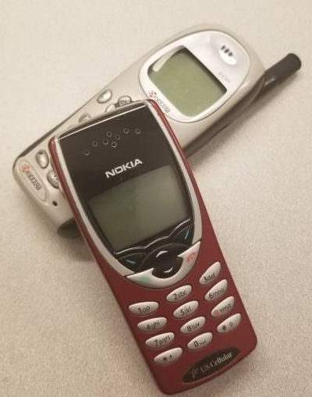
Generations
$400
Clue:
This was the first generation of digital technology.

Slide 16
Generations
$400
Answer:
What is 2G?

Slide 17

Generations
$600
Clue:
This generation will allow device-to-device communication, for example, self-driving cars.

Slide 18
Generations
$600
Answer:
What is 5G?

Slide 19
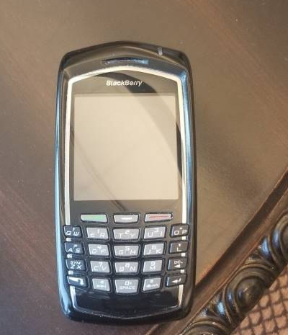
Generations
$800
Clue:
Smartphones, increased data speeds, and security were introduced in this generation.

Slide 20
Generations
$800
Answer:
What is 3G?

Slide 21
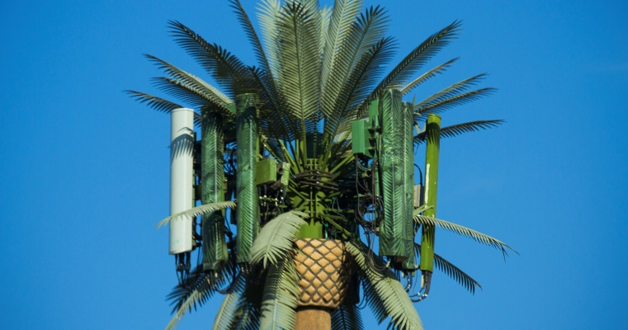
Generations
$1000
Clue:
Introduced with 4G, this enables calls and data usage at the same time.

Slide 22
Generations
$1000
Answer:
What is VoLTE (Voice over LTE)?

Slide 23

Network
$200
Clue:
This structure houses electronic equipment needed to conduct wireless communication.

Slide 24
Network
$200
Answer:
What is a cell tower?

Slide 25

Network
$400
Clue:
When a text message is sent, it travels from the first phone to the nearest cell tower to connect to the network. The connection then travels to this place.

Slide 26
Network
$400
Answer:
What is the messaging center?

Slide 27

Network
$600
Clue:
To upload your latest selfie on your favorite app, the connection travels here to complete the request.

Slide 28
Network
$600
Answer:
What is the switch?

Slide 29
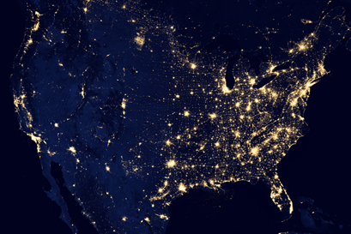
Network
$800
Clue:
Your device must communicate with this “out this world” equipment to establish a location before using GPS.

Slide 30
Network
$800
Answer:
What are satellites?

Slide 31
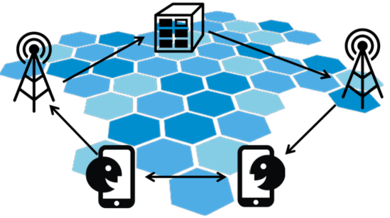
Network
$1000
Clue:
If you call your bestie on your mobile device, the connection must travel to these three places, in order, before you hear them say hello!

Slide 32
Network
$1000
Answer:
What are the nearest cell tower, then the switch, and then the cell tower closest to the receiving phone?

Slide 33

Internet of Things (IoT)
$200
Clue:
IoT is the acronym for the future of wireless technology, what does it stand for?

Slide 34
Internet of Things (IoT)
$200
Answer:
What is Internet of Things?

Slide 35

Internet of Things (IoT)
$600
Clue:
These services process data sent from sensors and devices, they also produce rain.

Slide 36
Internet of Things (IoT)
$600
Answer:
What are cloud services?

Slide 37
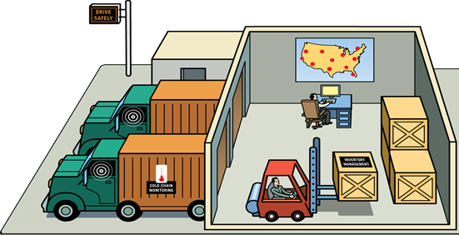
Internet of Things (IoT)
$800
Clue:
This industry uses IoT to track deliveries, monitor drivers, and run diagnostics on equipment.

Slide 38
Internet of Things (IoT)
$800
Answer:
What is the transportation industry?

Slide 39
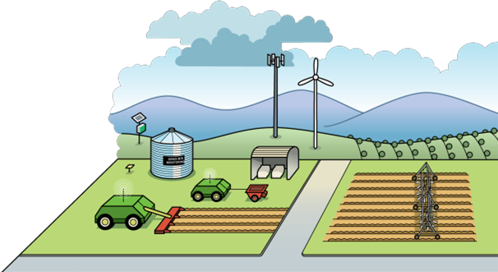
Internet of Things (IoT)
$1000
Clue:
This profession benefits from IoT by capturing product delivery, tracking cows, and monitoring tractors.

Slide 40
Internet of Things (IoT)
$1000
Answer:
What is a farmer?

Slide 41
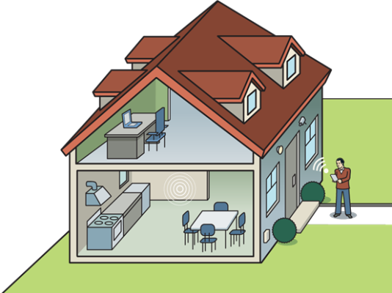
IoT Connected Community $200
Clue:
Sensors monitor lighting, temperature, humidity, and motion in this type of dwelling.

Slide 42
IoT Connected Community $200
Answer:
What is a smart home?

Slide 43

IoT Connected Community $400
Clue:
You could start laundry, and open and close your garage door remotely, if you owned these.

Slide 44
IoT Connected Community $400
Answer:
What are smart appliances?

Slide 45

IoT Connected Community $600
Clue:
This company uses fleet management software to track driver routes, hours, and speed.

Slide 46
IoT Connected Community $600
Answer:
Who is Uber?

Slide 47
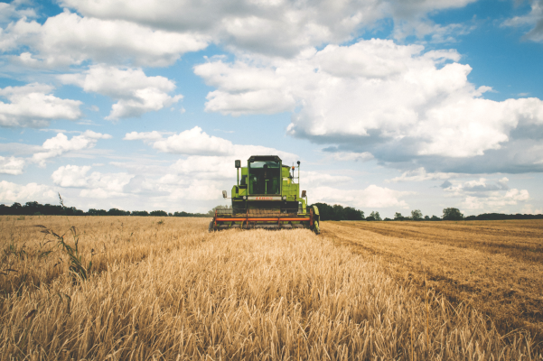
IoT Connected Community $800
Clue:
You could create the world’s best corn field maze using this type of technology.

Slide 48
IoT Connected Community $800
Answer:
What is sensor technology?

Slide 49

IoT Connected Community $1000
Clue:
You could use this equipment to catch Fluffy sitting on the couch again, leaving pet hair.

Slide 50
IoT Connected Community $1000
Answer:
What are smart security cameras?

Slide 51

Wireless Fun Facts
$200
Clue:
This parent is more likely to give their child a phone in elementary school.

Slide 52
Wireless Fun Facts
$200
Answer:
Who is Dad?

Slide 53

Wireless Fun Facts
$400
Clue:
This is the single most used feature on a smartphone. People do this, more than they use the internet.

Slide 54
Wireless Fun Facts
$400
Answer:
What is text?

Slide 55

Wireless Fun Facts
$600
Clue:
More than 4 billion people own mobile phones, but only 3.5 billion use this daily item.

Slide 56
Wireless Fun Facts
$600
Answer:
What is a toothbrush?

Slide 57
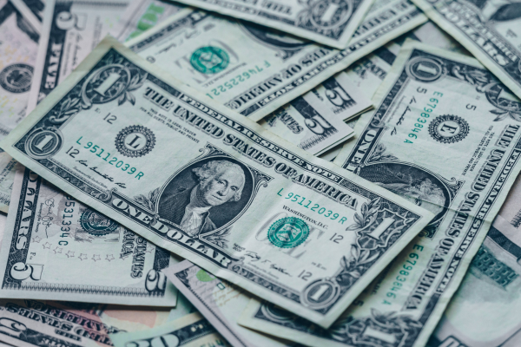
Wireless Fun Facts
$1000
Clue:
The cost of the first mobile phone in 1983.

Slide 58
Wireless Fun Facts
$1000
Answer:
What is $4000?

Slide 59
Final Jeopardy
Details, Details, Details

Slide 60


Final Jeopardy
Clue:
The name of this course.

Slide 61
Final Jeopardy
Answer:
What is Wireless Fundamentals?

Slide 62
Daily Double
Daily Double

Slide 63

Internet of Things (IoT)
$400
Clue:
These are downloaded to a wireless device and interact with smart devices; you may need a play store to find them.

Slide 64
Internet of Things (IoT)
$400
Answer:
What are applications or apps?

Slide 65
Daily Double
Daily Double

Slide 66

Wireless Fun Facts
$800
Clue:
You seek this out, more than Grandma’s birthday money; the acronym is short for Wireless Fidelity, and it is recognized by this symbol

Slide 67
Wireless Fun Facts
$800
Answer:
What is WIFI?

